Slide 1

FACTORS INFLUENCING PROCRASTINATION IN OUR DAILY LIFE
Under the Guidance of Professor Bhuvaneswari M
Team Leader : Ansh G V

Slide 2

TEAM MEMBERS
Ansh G V - 19BME0274
Paritosh Kumar Patro - 19BME0387
Ashish Anand - 20BCE0369
Mothishwaran C - 19MID0017
Sabarinathan R V - 19MID0057
Tharun S - 19MID0031
Prashanth S - 19MID0020
Udhaya Priya S - 19MID0058
Bazaru Syam Sai Abhilash - 19BME0687

Slide 3

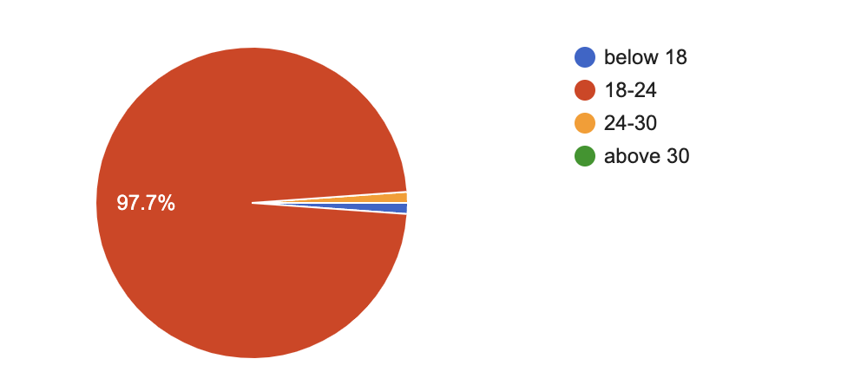

Slide 4
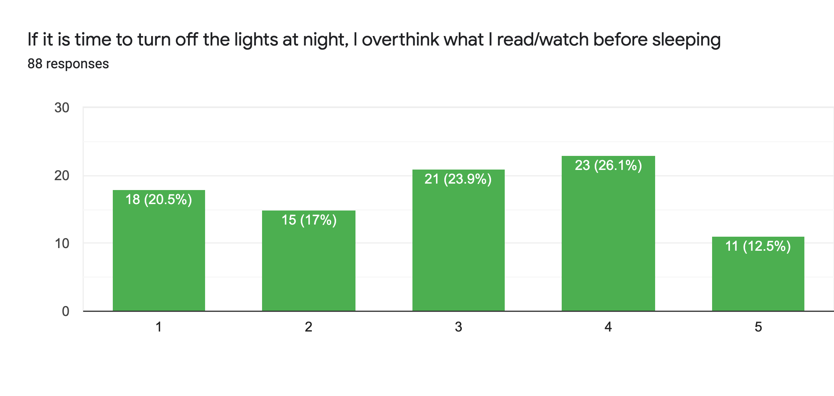
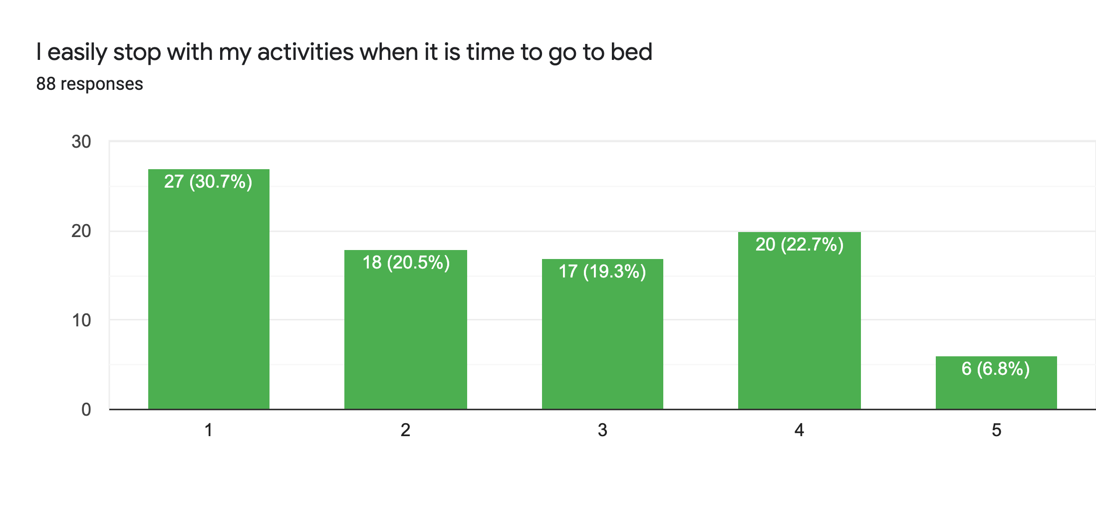
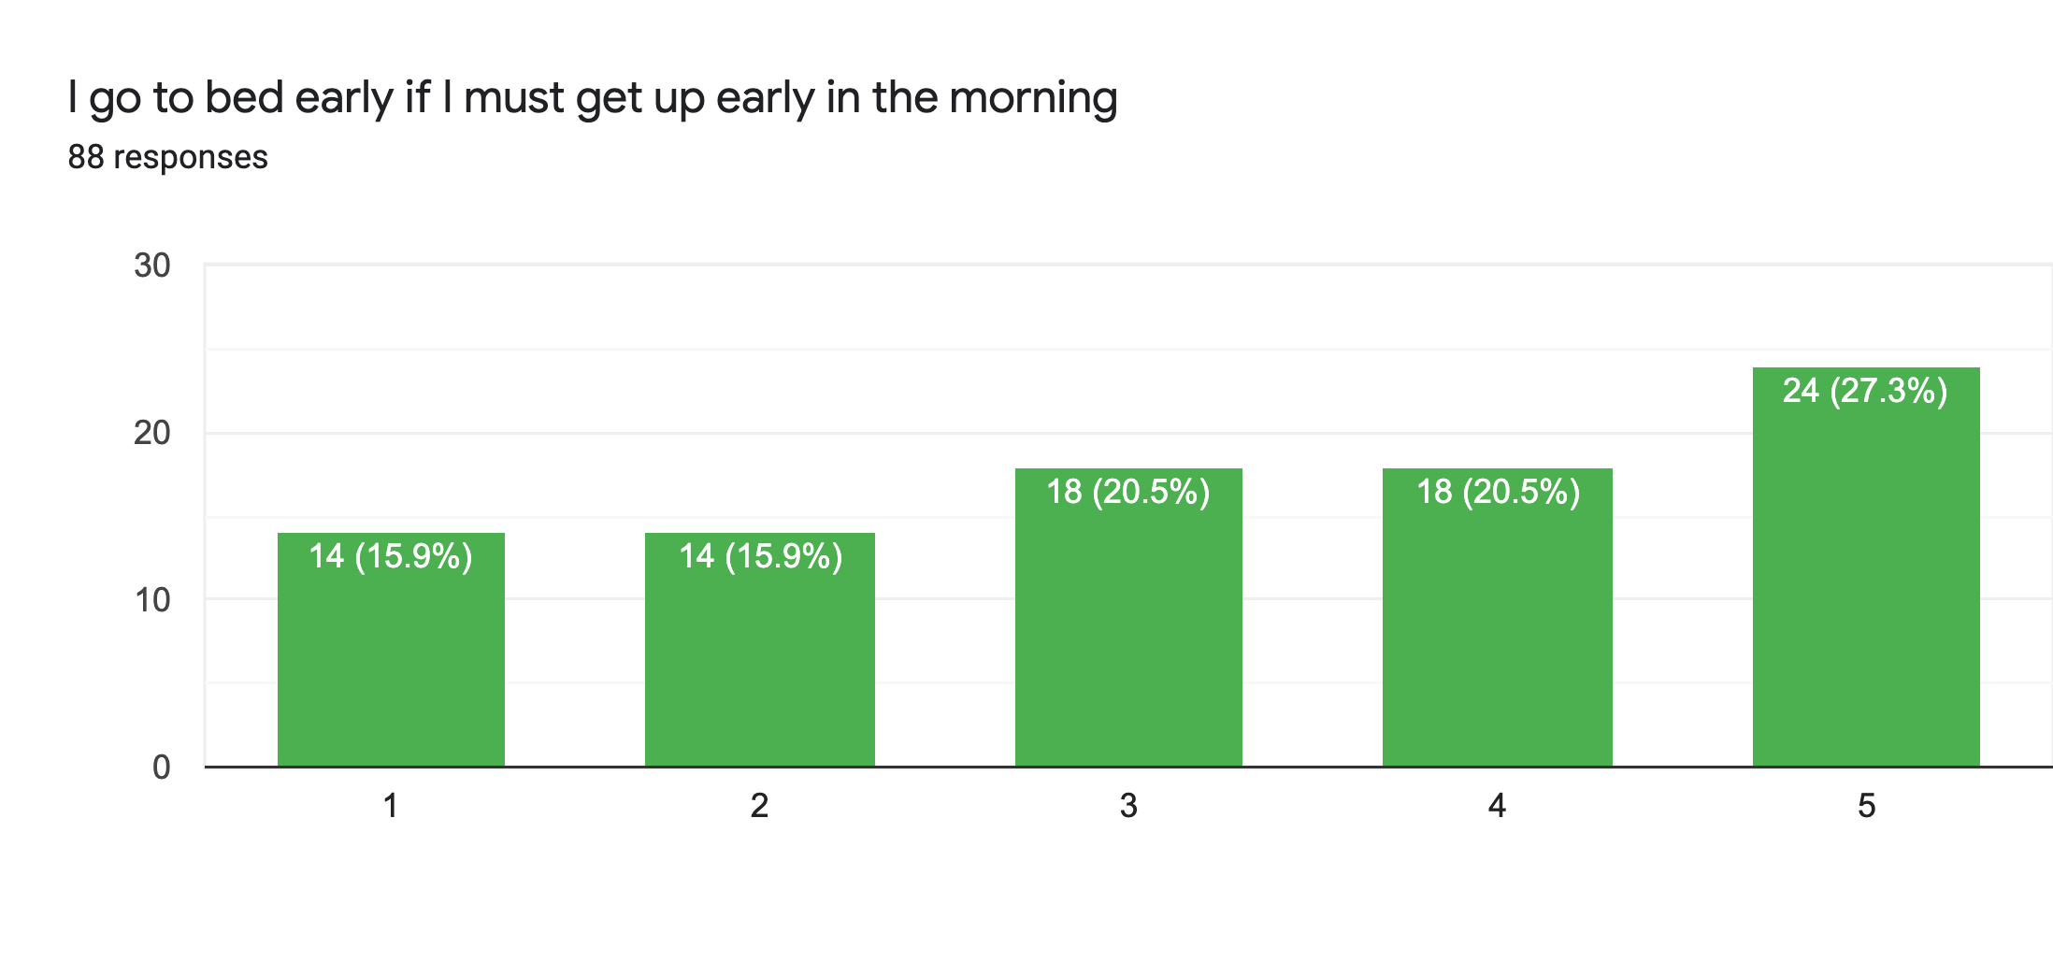
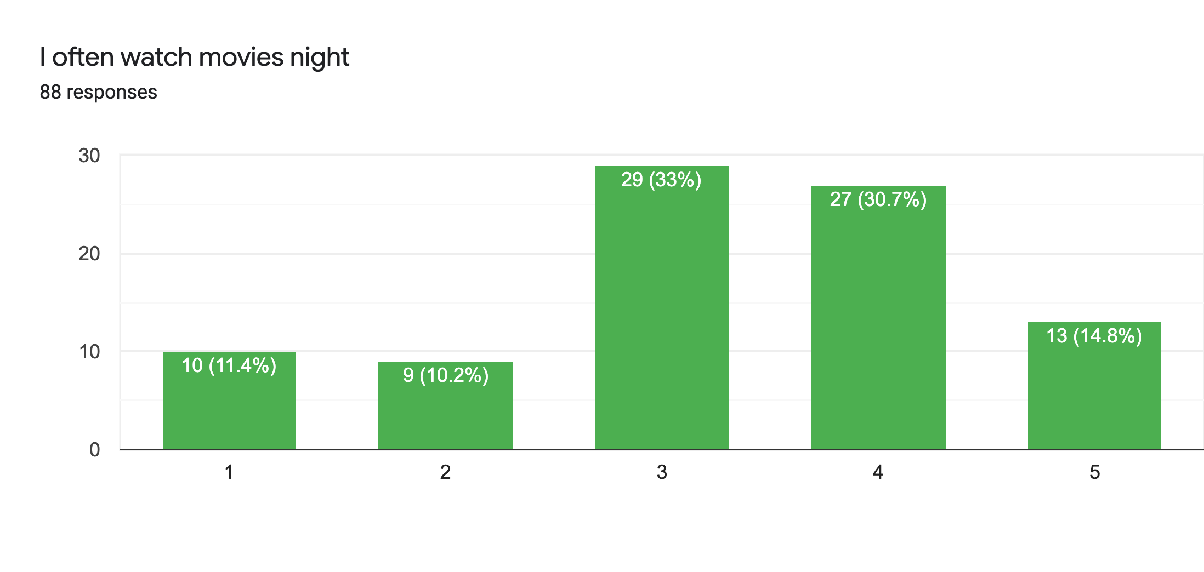
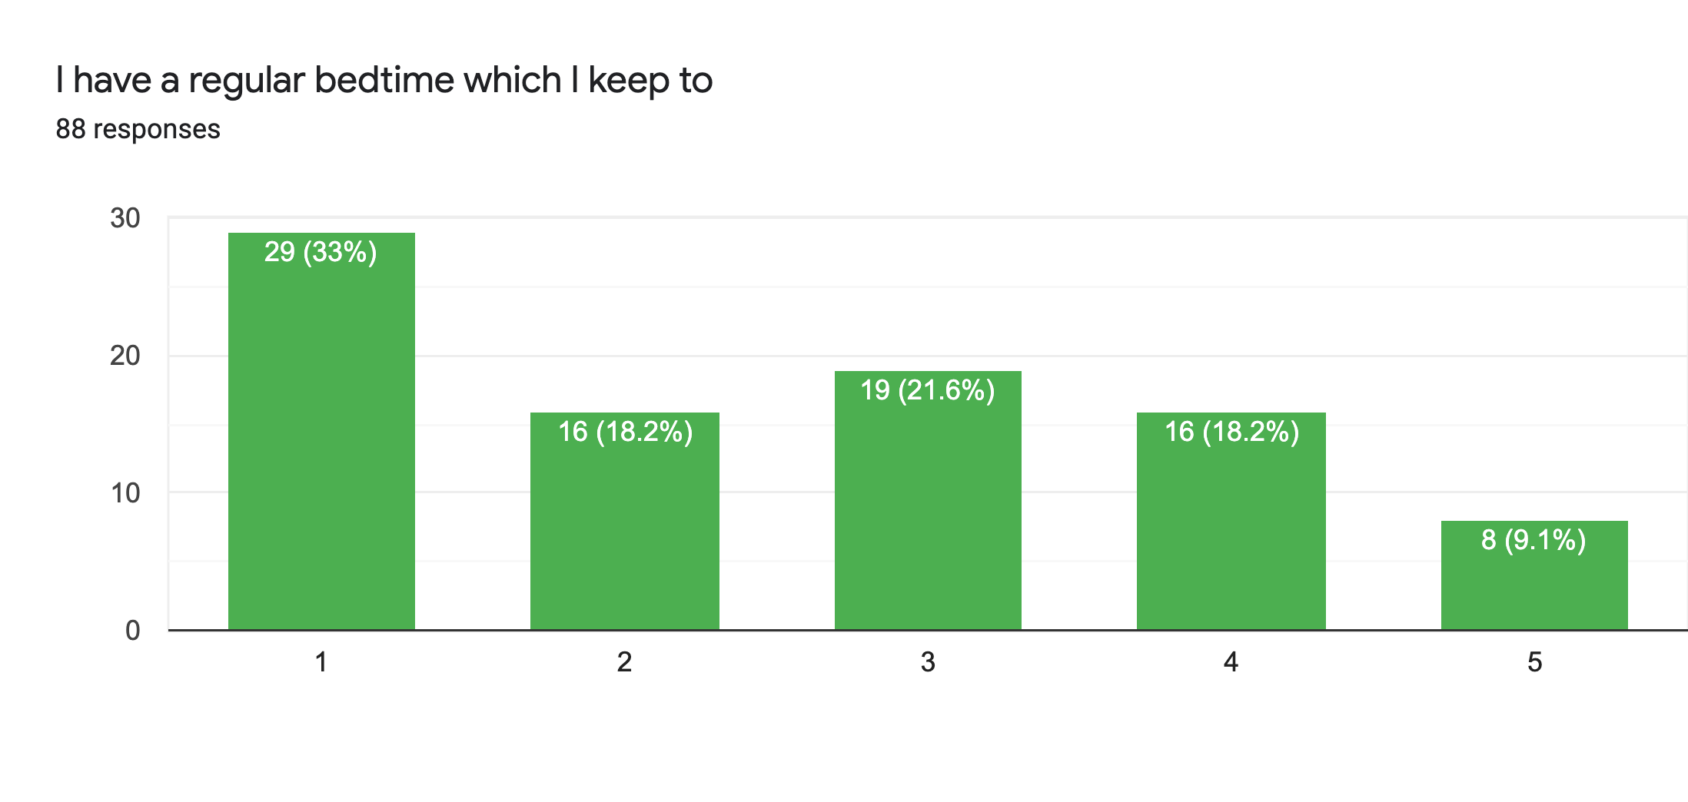
To investigate if watching/reading before bedtime makes us procrastinate in our sleep

Slide 5
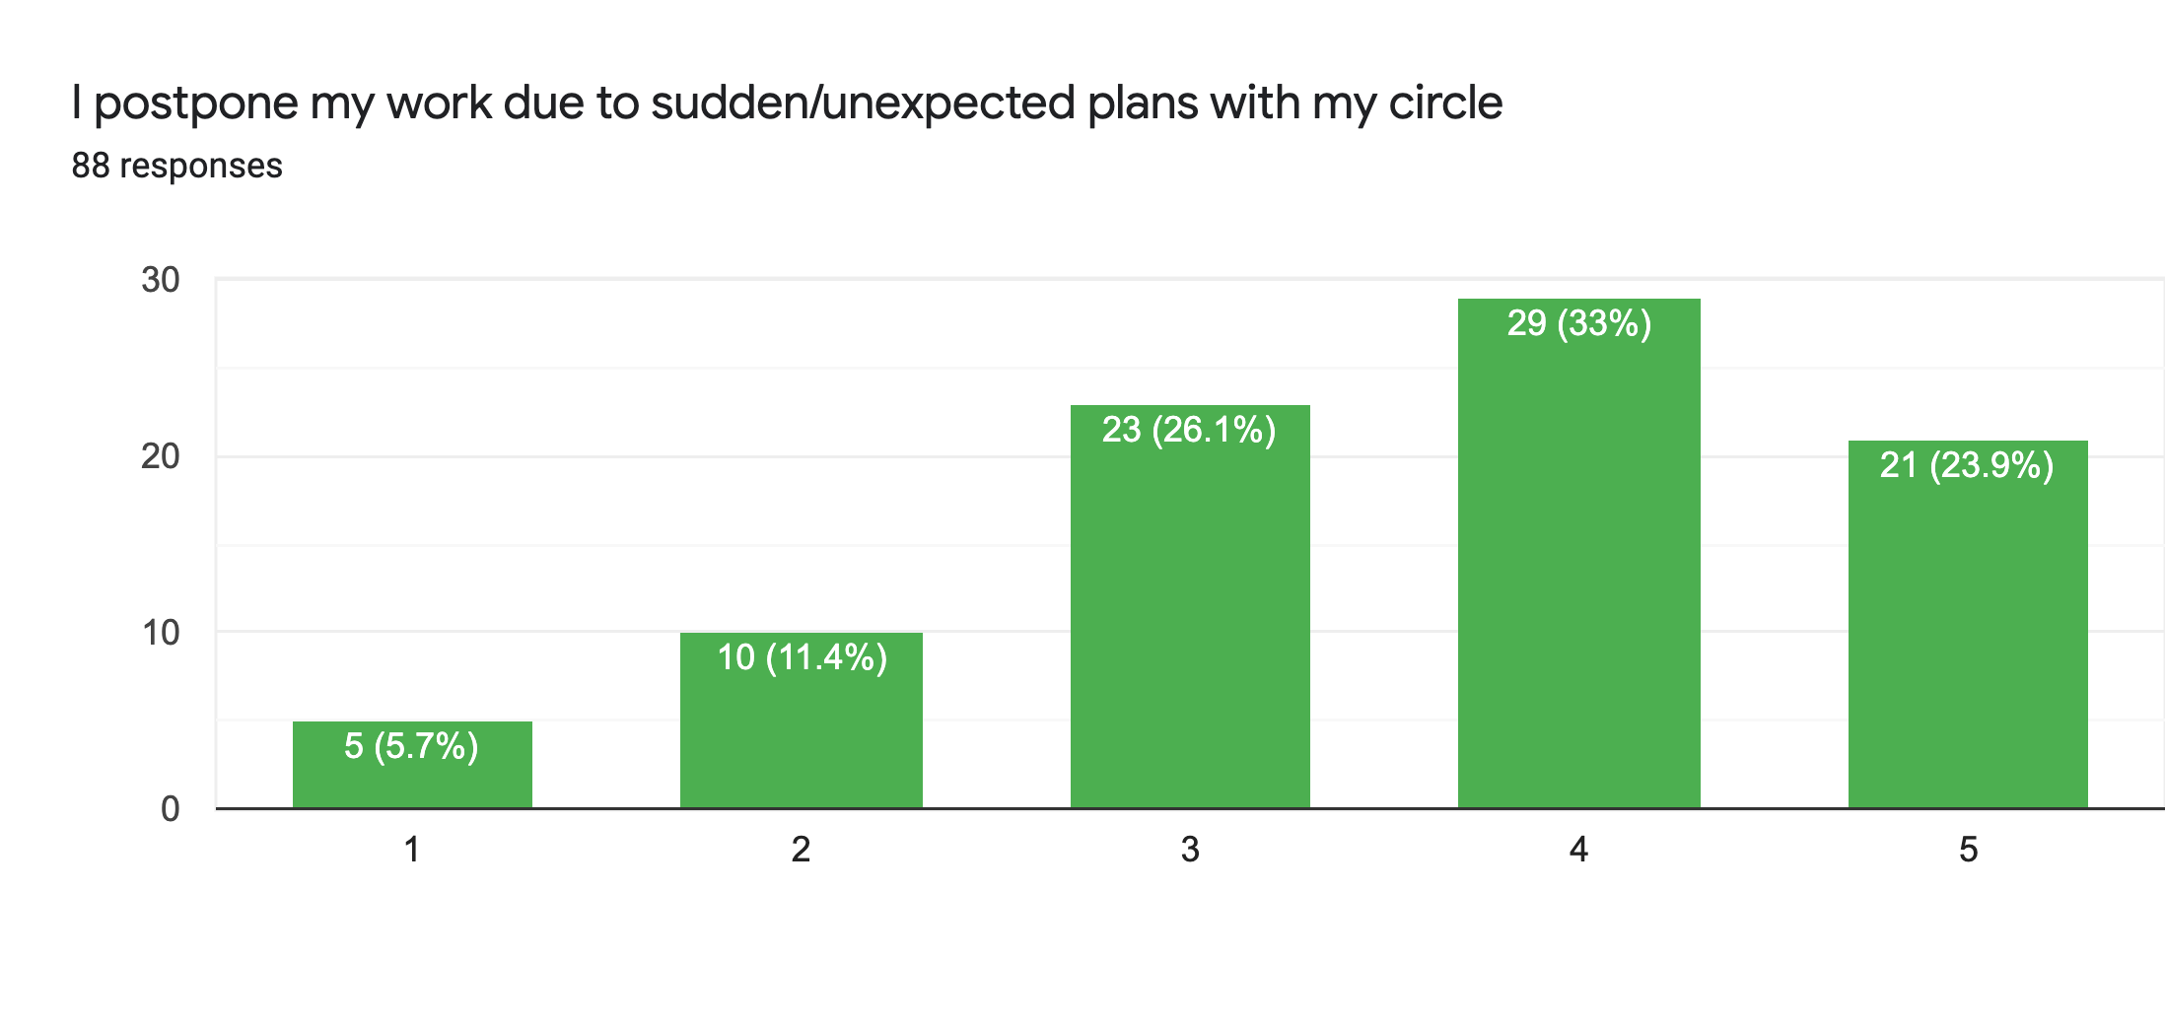
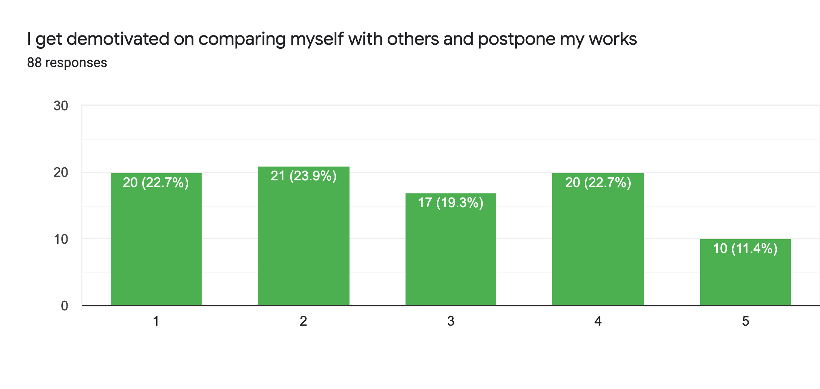
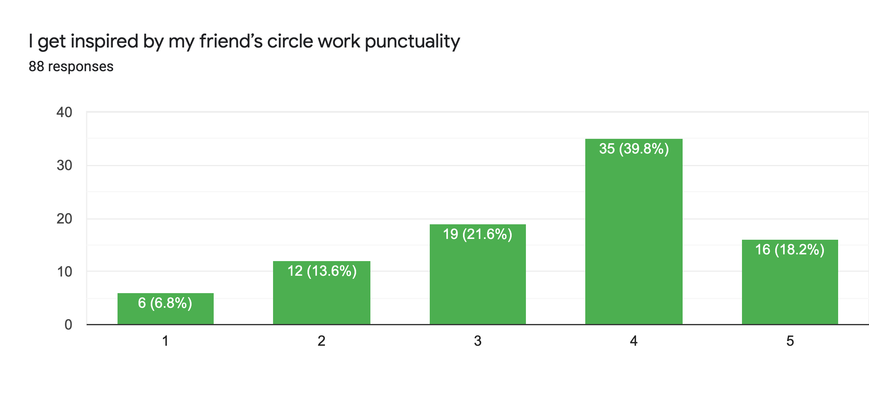
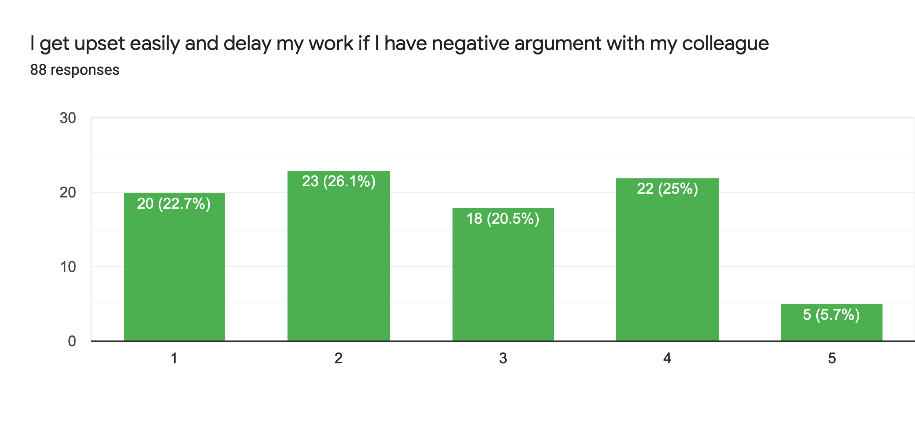
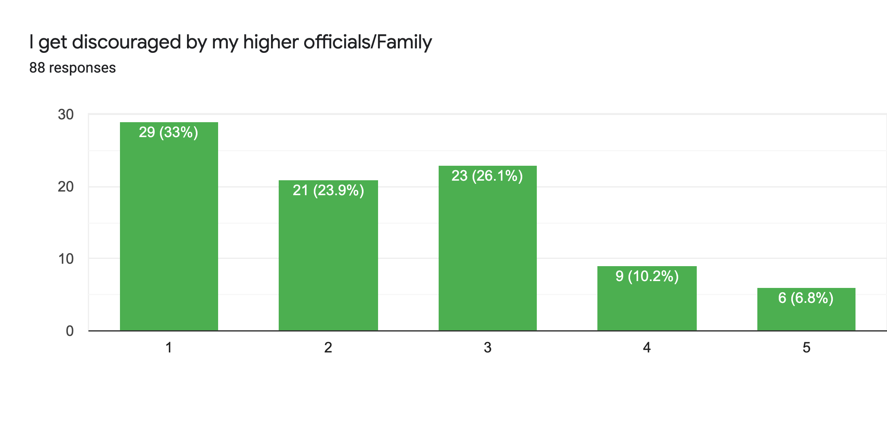
To investigate whether the type of people around us make us procrastinate in our daily work/activities

Slide 6
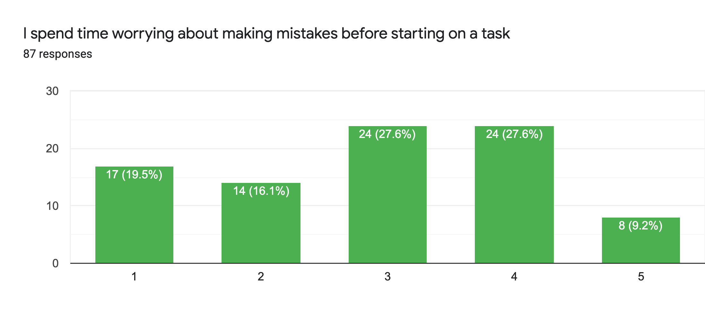
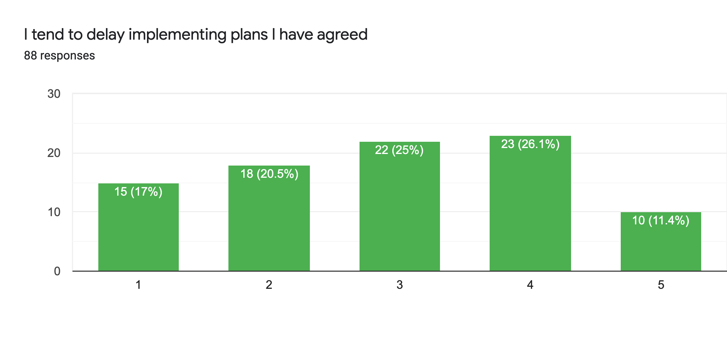
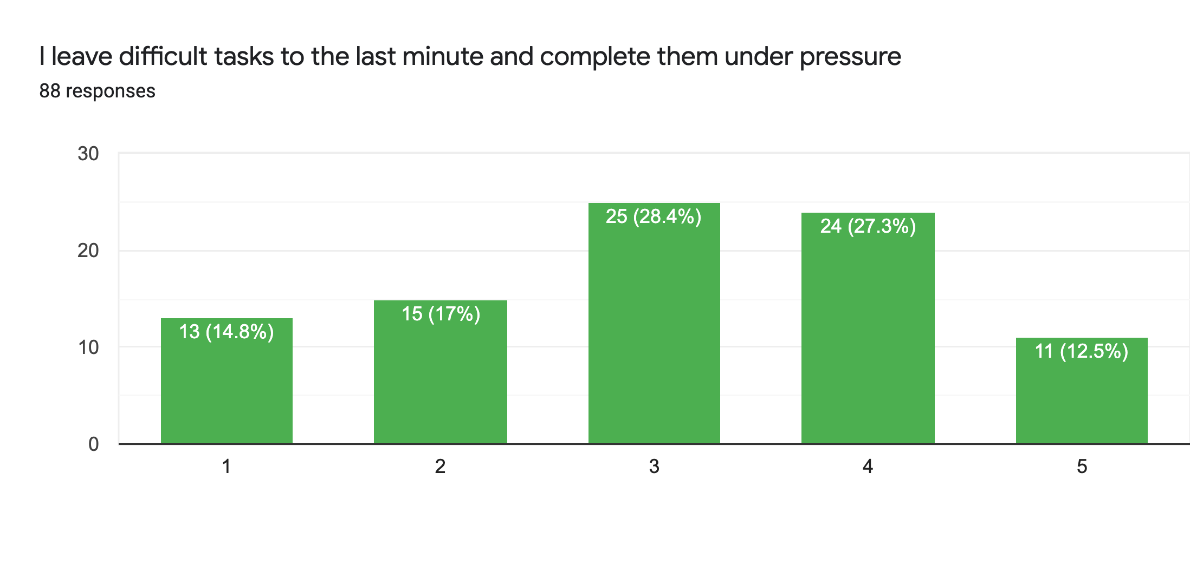
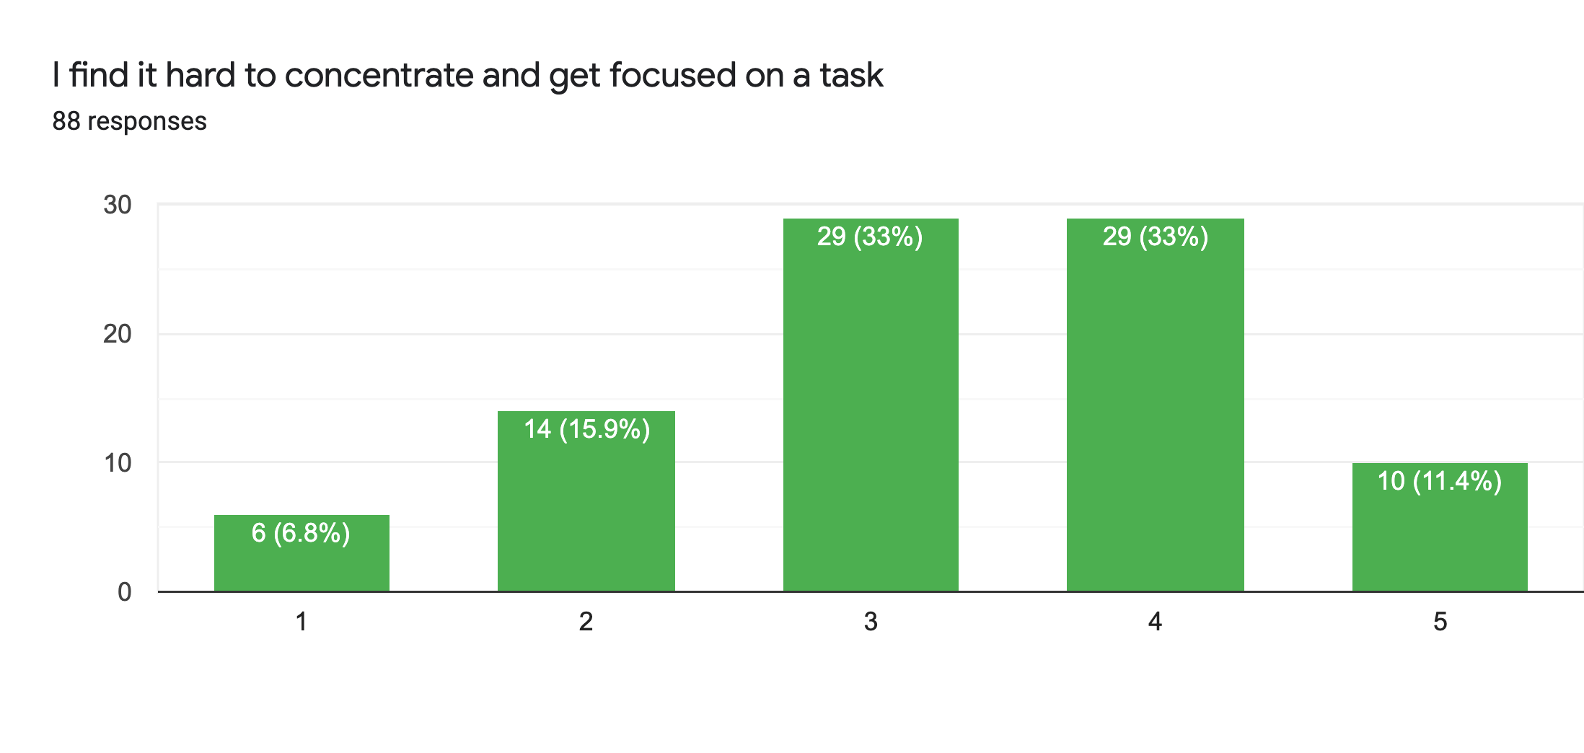
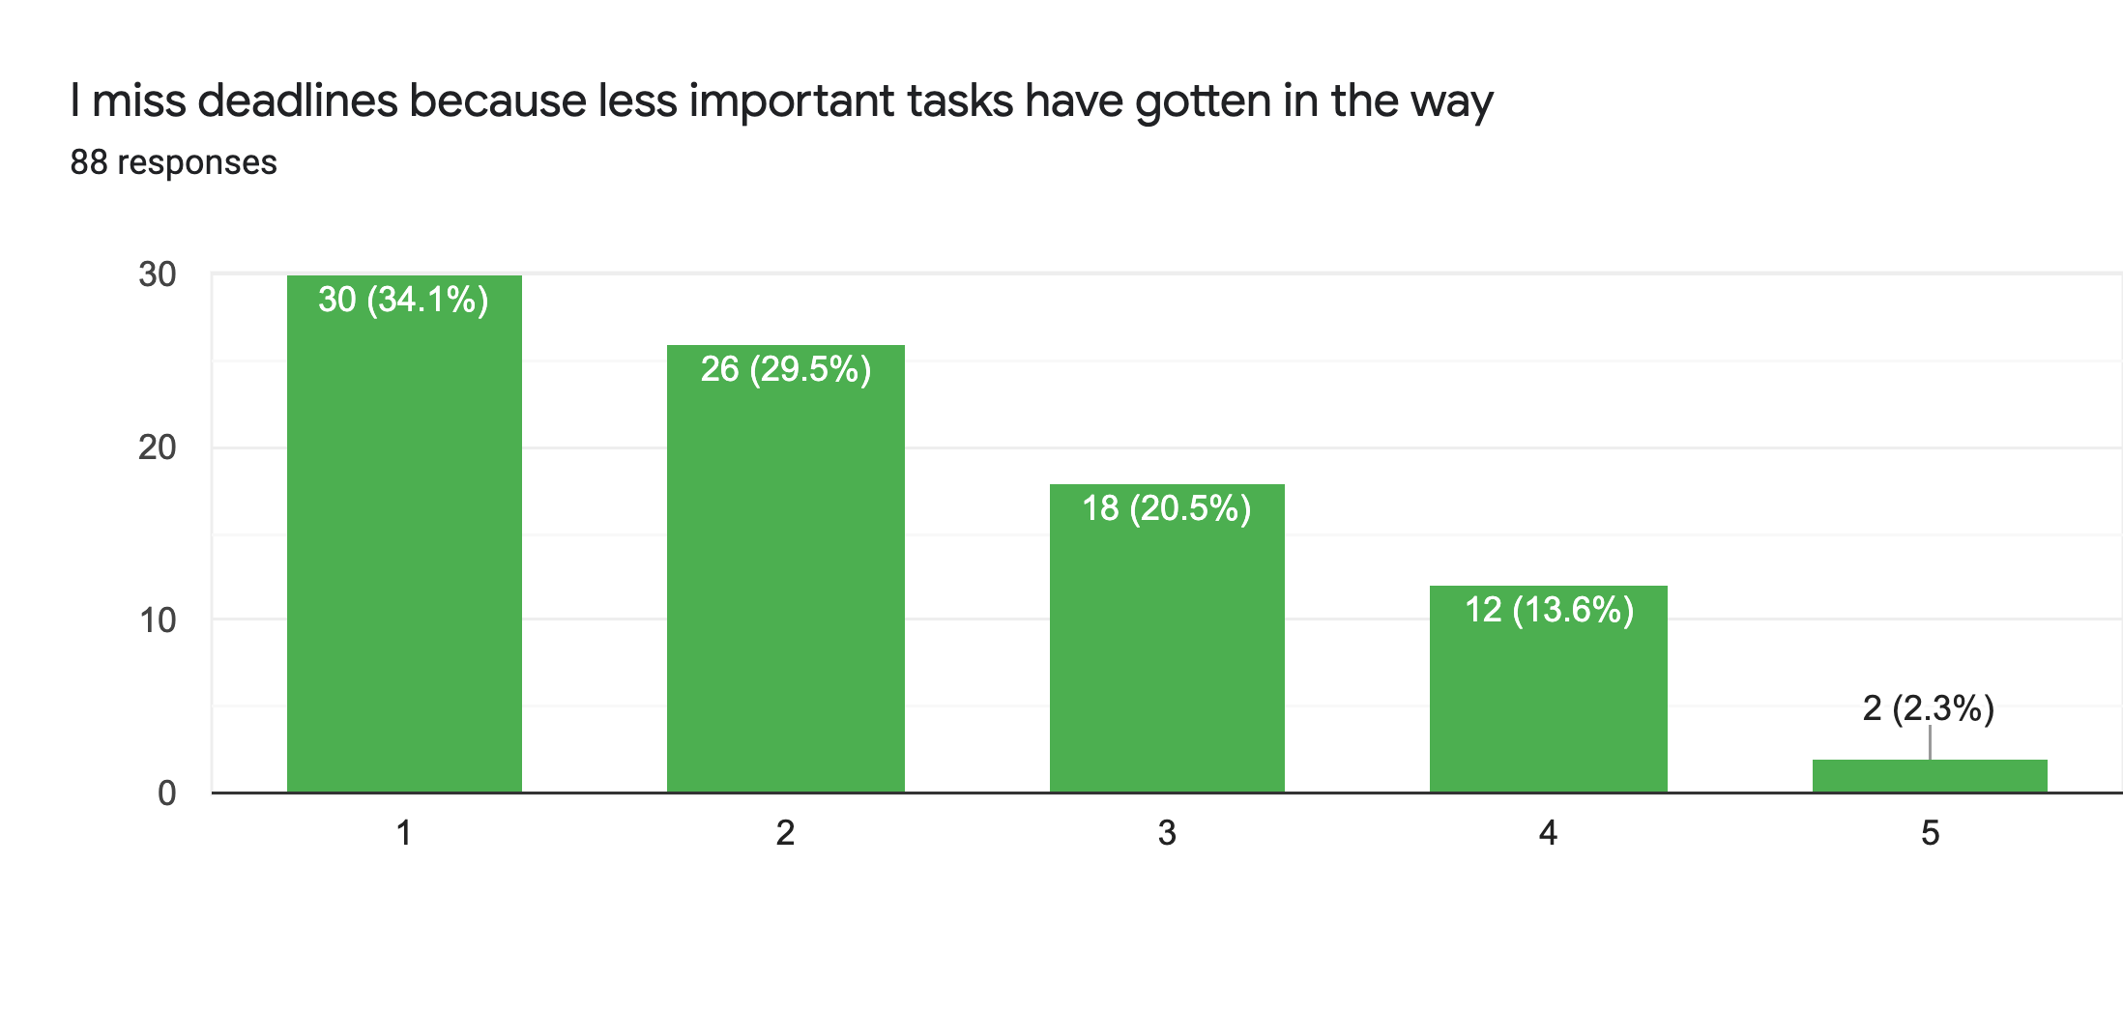
To investigate whether the type of people around us make us procrastinate in our daily work/activities

Slide 7
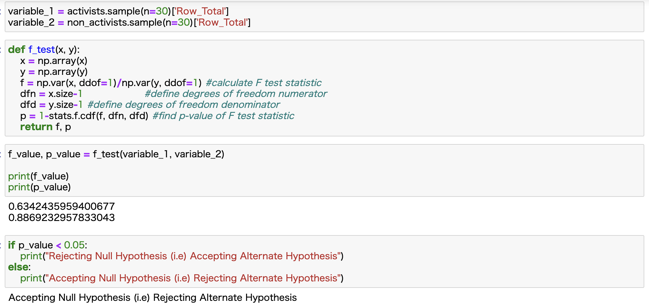
OBJECTIVE 1

Slide 8
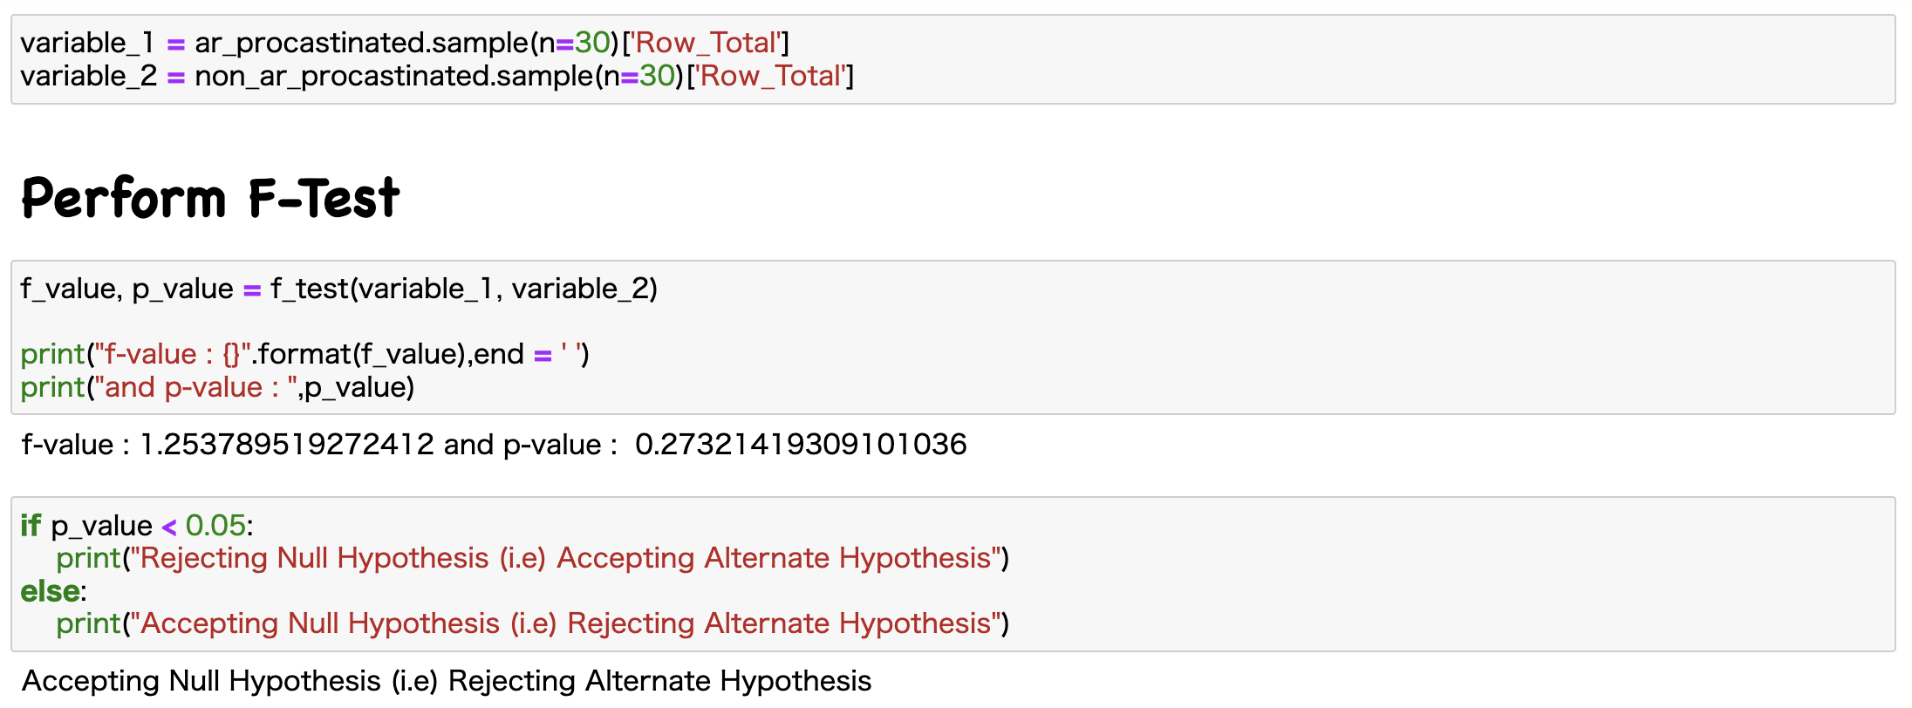
OBJECTIVE 2

Slide 9
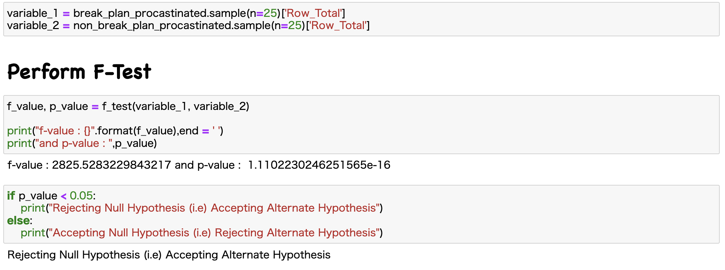
OBJECTIVE 3

Slide 10
THANK YOU
!!!

